Slide 1

Competitive Programming From Problem 2 Solution in O(1)
P
T
H
I
N
K
F
A
S
T
S
C++: Multidimensional Arrays
Mostafa Saad Ibrahim
PhD Student @ Simon Fraser University

Slide 2
Multidimensional Arrays
We knew how to represent set of numbers (e.g. Representing students grades) using 1D array
What about representing students grade per subject
Mathematically this equals to matrix (2D)
Rows = students. Columns = subjects. Cell Value = Grade
What if we want these students grades but also cross the semsters? We need 3D representation

Slide 3
Multidimensional Arrays: Examples
2D Arrays
int students_grades[100][5];
100 students, 5 subjects
Or any other type: double students_grades[100][5];
3D Arrays
int students_grades[3][100][5];
3 semeters, 100 students, 5 subjects
4D Arrays
int students_grades[4][3][100][5];
4 years, 3 semeters, 100 students, 5 subjects
And so on
string names[10][4][6][2][9][1000] ; => 6D array of strings

Slide 4
2D Arrays
2D arrays are very popular in programming
Sometimes we need more (e.g. 3D, 4D..).
We will focus on 2D
What we do in 2D can be done with higher dimensions

Slide 5
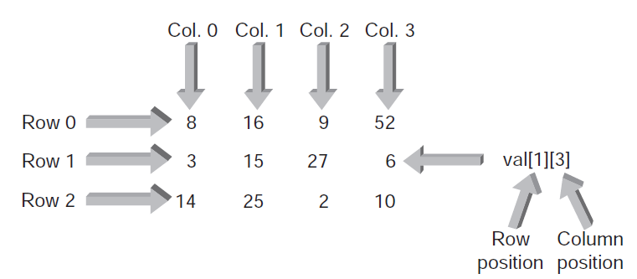
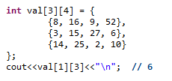
2D Array - Visualizing
Notes:
Source 1st image: Bronson G. - A First Book of C++ - 2011

Slide 6
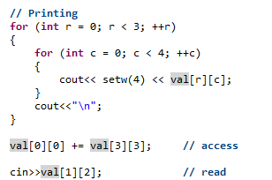
2D Array - Accessing
Row Major Order

Slide 7
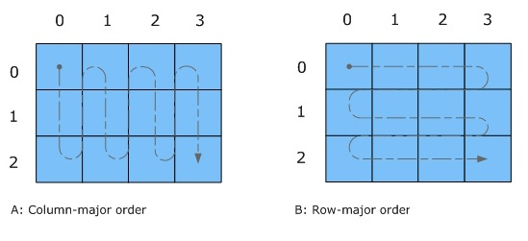
2D Array – Iteration Direction
Notes:
Source: https://software.intel.com/sites/default/files/did_feeds_images/3EADF871-3C3F-484E-8225-CA05A4D00E38/3EADF871-3C3F-484E-8225-CA05A4D00E38-imageId=386E9E4F-F269-4C5F-8CCC-10DC5E71BCBB.jpg

Slide 8
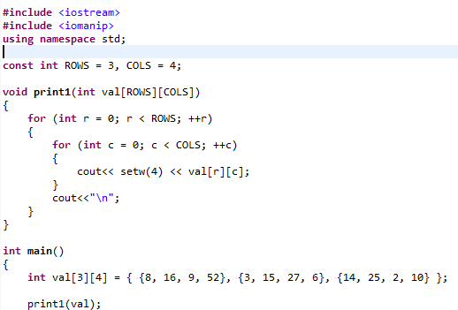
2D Array - As Arguments

Slide 9
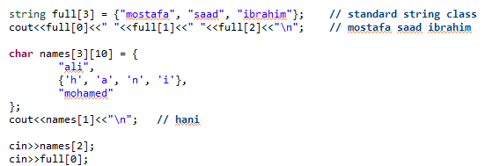
2D Array - Strings

Slide 10
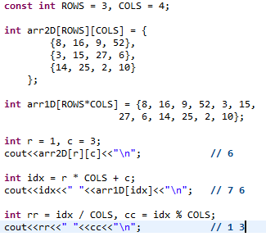
Flatten : 2D ⬄1D

Slide 11

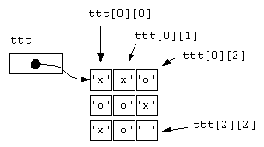
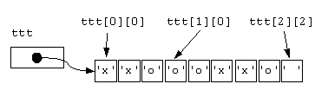
2D Array Storage: Layout
Rows are laid out sequentially in memory
Visually
Memory
Notes:
Source: http://www.fredosaurus.com/notes-cpp/arrayptr/23two-dim-array-memory-layout.html

Slide 12
Locality of reference
Does it matter to access array in row major order or column?
Yes, affects operation speed.
Usually, row major order is faster. However, this depends on Machine Architecture
More details in video:
Algorithms - Misc - 05 – Adhocks
~ Minute 38

Slide 13
Homework
How to flatten (map) 3D/4D position to 1D?
If possible, try 1D array excercises on 2D?
E.g. Get 2nd maximum in 2D Array

Slide 14
تم بحمد الله
علمكم الله ما ينفعكم
ونفعكم بما تعلمتم
وزادكم علماً

